Slide 1
ABAP on HANA

Slide 2
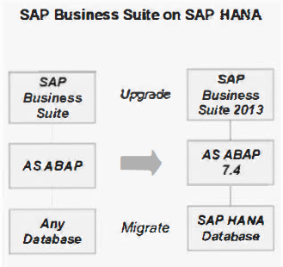
Code Migration
Generally speaking, all the code that runs on your existing platform will continue to run as before on SAP HANA.
The migration of the ABAP customer code for SAP HANA can be split into two main areas:
Functional modifications of the customer code
SQL performance optimization of the customer code

Slide 3
Some parts of the old code might lead to functional issues.
For example, you were using a summarization table in the legacy code, but this table no longer exists. This can happen, for example, if you migrate the legacy Business Suite accounting to Smart Finance.
There might be some old code which is contrary to some programming rules for good performance.
Maybe there are some critical business processes which should run faster.
First of all, you need to find and replace any parts of the code that rely on database-specific features, such as native SQL statements, and the use of DB hints in Open SQL statements.
You need to identify, examine, and possibly replace, code that relies on implicit sorting done by the database.
Cluster tables, and some of the pool tables ,will be transformed into transparent tables and the relation between them will then be broken.

Slide 4
Tools
Usage and Procedure logging (UPL).
UPS is a kernel function that retrieves usage data about report processing, function modules (RFCs), and methods from the kernel .
You can use the solution documentation assistant to access this usage data.
You can create UPL check steps for the following object types:
Reports
Function modules (RFCs)
Methods
(Recommendation: The analysis period should more than one month)

Slide 5
Tools
The ABAP SQL Monitor. (T-Code : SLWT)
This tool is available with Netweaver stack 7.00 and above.
It has the following functions:
Traces each and every SQL statement coming from an ABAP program. This includes OPEN SQL, native SQL and SQL statements coming from the ABAP kernel.
Can be switched on for all or dedicated servers of an ABAP system.
The data collection is highly optimized by using kernel functionality and can run in a productive system (<3%).
Allows downloading SQL Monitor data in order to import it in a development system where the code corrections are done.

Slide 6
Tools
Code Inspector
With this tool, you can define variants of which elements you want to analyze.
It is part of the ABAP Test Cockpit (ATC).
ABAP Test Cockpit is based on Code Inspector and adds new quality gates, quality processes and better usability.
The code quality manager can schedule periodic runs, add quality gates with priorities, and publish the results back to developers.
The code inspector performs a static check. But there is a also a dynamic check offered by the Runtime Check Monitor, which is quite a new transaction.

Slide 7
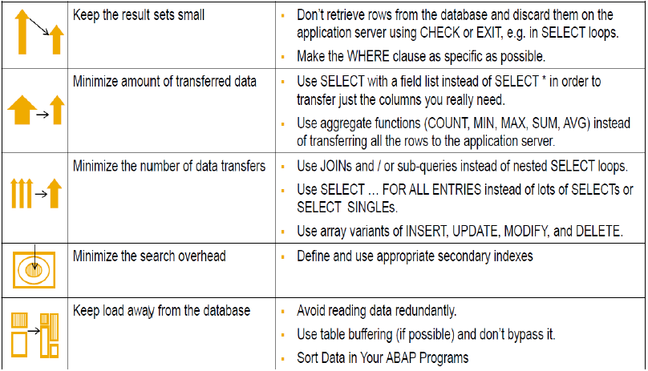
Performance guidelines for ABAP DB access

Slide 8
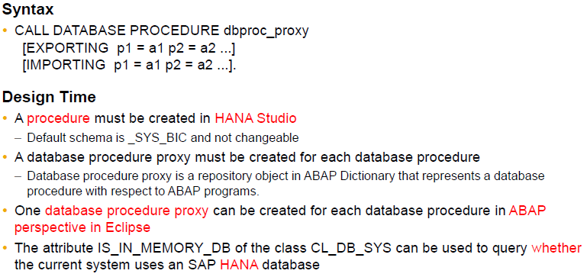
CALL DATABASE PROCEDURE

Slide 9
THANK YOU

